Slide 1

Continuous Quality Improvement (CQI): Selecting a Topic & Root Cause Analysis
Notes:
Hello everyone, my name is Grace Kinne and today I will be presenting the second prerecorded CQI workshop. Today we will be discussing selecting a topic for your CQI project and root cause analysis

Slide 2
CQI Process
Broken down into 4 main steps
Form a CQI Team
Identify Improvement Area
Plan-Do-Study-Act
Lessons Learned
Notes:
As you may recall from the last pre recorded workshop, CQI is broken down into 4 main steps. Last time Clem discussed the first step, forming a CQI team. Today we will be discussing the second step, identifying an improvement area.

Slide 3
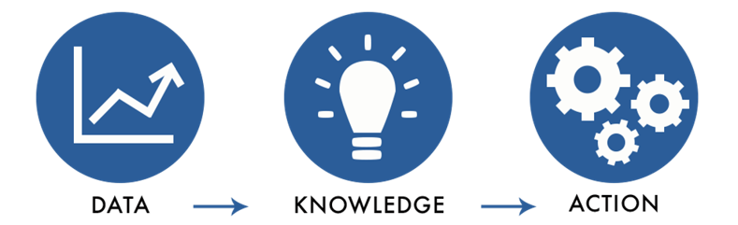
Selecting a Topic
(Graphic credit: Radhika Bhatt, U.S. Department of Commerce Data Service)​
Notes:
The best way a program can identify their CQI project is through the use of data. Data are a tool that illuminate the aspects of a program that might not be working as efficiently as it could be. Thus, it shouldn’t be looked at as a form of punishment if we see something that isn’t working as well as it could be but rather as an opportunity to now improve an identified area important to the program. ​
​
Other ways you could measure areas of improvement are: ​
Performance Targets​ or indicators
Feedback from participants, staff, or community advisory board

Slide 4

Smart
Measurable
Attainable
Relevant
Time-bound
Inclusive
Equitable
Creating a SMARTIE Goal
Notes:
Goals are a concrete way to drive results, but without an explicit equity and inclusion component, goals won’t produce better outcomes for marginalized communities, address disparities, or support belonging. When writing your goal you want to make sure that it is smart, measurable, attainable, relevant, time bound, inclusive, and equitable. We will go further into depth on each of these components over the next few slides.

Slide 5

Specific
Specific
Attainable
Measurable
Relevant
Time-bound
Inclusive
Equitable
Notes:
First, specific. Aims must be specific to guide you toward improving an outcome. The more specific the goal, the easier it will be to identify processes for improvement, and for the CQI team to know that they have actually achieved the goal of alleviating the issue. To help with making sure that the topic is specific as simple as it sounds, we should use the traditional: ​
Who? - Who is being affected by the goal, who is impacting this goal – so who is going to be affected with changes
What? - What is the major objective? – what change do you want to see?
Where? - Where is this change occurring? (i.e. where in the process is this change going to be implemented?).
When? - When do you want to see this change occur? For us this would mean you want to have your CQI change plans completed and implemented by October 31st 2023 maybe? ​
Why? Why will doing your CQI project improve an area of concern? ​
​
If these questions can be answered clearly and concretely then you know that the topic/issue is specific. ​
Really make sure that the wording of the issue is clear and concrete, so the goal is understandable. When teams come together to discuss the aim, ambiguity can be clarified by asking team members to indicate what the aim means for them. Be sure each member’s interpretation aligns with the goal. ​
​
A final tip for the CQI team is once they have workshopped their topic to be specific, they can ask others outside the CQI team who are less familiar with the goals to interpret the aim can serve as another check for clarity.

Slide 6

Measurable
Specific
Attainable
Measurable
Relevant
Time-bound
Inclusive
Equitable
Notes:
Next SMARTIE goal criteria is measurable. This again is that the outcome of the change plan needs to be measured by collected data. ​
​
In order to achieve this criteria it is helpful for the CQI team to ask: ​
How can the outcome of interest be translated into a measurable data element? In other words, how can the achievement of the goal be captured in data? What sort of questions can we create that will measure the outcome if it is already not being collected. Are there data currently being collected on this outcome? If not, what needs to be done to collect these data? ​
​
Is the outcome measure quantifiable (e.g., does it give a value or number to be used in the calculations)? If not, it will not be a suitable measurement for CQI projects.​
We need to be able to prove that the change plan is working/successful so the CQI team needs to be able to show what the issue looked like before and after their change strategy.

Slide 7

Attainable
Specific
Attainable
Measurable
Relevant
Time-bound
Inclusive
Equitable
Notes:
The next criteria for SMARTIE goals is Attainable. Often when improvement efforts begin, staff want to get started and are excited to make changes and there is a risk to either throw multiple improvement efforts out or setting a massive goal that is not attainable and can impede CQI efforts by slowing down the CQI team. Really we need to pull back the amount we want to do even if we are enthusiastic (and we hopefully are) to make it an accomplishable goal. ​
​
There are multiple questions that the CQI team can ask to help with this as well: ​
First they can ask: ​
Can direct service impact this goal?​​
They should be able to since they are ones delivering the services, and often might be the ones implementing the change strategy. ​
​
The next question has a couple parts to it for the CQI team it is: ​
​
Is there evidence of the service influencing this goal? In other words, has past research shown a link between the service and the outcome the team is working to achieve? ​
The CQI team is going to need to do some sort of search in prior research to see if there has been any work do on this already. If they find evidence that it already is not going to work then the CQI team is working toward an unattainable goal. ​
​
The next question also has some complexities to it. The next question is to ask: ​
​
Is it changeable? If it does not seem changeable, why not?​​
This is a complicated concept. First, a condition may appear to be unchangeable when in fact it can be changed. Or, the condition can be changed, but it is outside the scope of the program.
​
The final question the CQI team needs to ask is the initial goal too large? ​
Setting smaller, more incremental goals at the beginning is important. Once the initial goal is attained, the CQI team is allowed reset the target to a higher standard for a second period. ​​
This is something to keep in mind that adjusting the strategies used for making improvements as progress is made is a process apart of CQI in general. As we discussed in the last talk there is supposed to be an interaction with the data by the CQI team if they find that something is working or not they can make adjustments while they are currently implementing the change strategy this can help them become successful it was not or even more successful.​
​
****NOTE**** - In addition to the last point we really want to stress this that we want you to be able to select realistic goals cause otherwise this is going to be incredible deflating for morale for a CQI team if you do not select an attainable goal. We recognize you are all busy and maybe not going to be able to obtain the perfect target here, and that is okay. What we do want to see though is strives for improvement.

Slide 8

Relevant
Specific
Attainable
Measurable
Relevant
Time-bound
Inclusive
Equitable
Notes:
SMART aims should focus attention where it is most needed. This element is about focusing on the aims that agencies want to or can address immediately. Aims can be attainable with reasonable targets, but they may not be relevant to the agency. ​​
​
To ensure that a SMART aim is relevant, ask the following questions: ​​
Is the aim related to your selected topic?​​
Is the aim meaningful to your team or agency?​​
Of all the things you could immediately work on, is this the most important for your agency and the families served?

Slide 9

Time-bound
Specific
Attainable
Measurable
Relevant
Time-bound
Inclusive
Equitable
Notes:
An aim without a timeframe is achievable, but difficult to manage since they guide the CQI work and propel the project forward. A specific timeframe inherently builds in motivation and accountability for the CQI team.​​
It’s important to make the timeframe as specific as possible. For example, “by October 31st, 2023” is better than “in 8 months.” cause then that turns into ​​
​
This a bit easier of the goals to obtain and the CQI team really only has 2 questions they have to answer. ​
Is the timeframe specific?​ and​
Is the timeframe attainable/realistic?​​
An aim without a timeframe is achievable, but difficult to manage since they guide the CQI work and propel the project forward. A specific timeframe inherently builds in motivation and accountability for the CQI team.​​
It’s important to make the timeframe as specific as possible. For example, “by October 31st, 2023” is better than “in 8 months.” cause then that turns into ​​
​
This a bit easier of the goals to obtain and the CQI team really only has 2 questions they have to answer. ​
Is the timeframe specific?​ and​
Is the timeframe attainable/realistic?​​

Slide 10

Inclusive
Specific
Attainable
Measurable
Relevant
Time-bound
Inclusive
Equitable
Notes:
The next step is being inclusive with the issue, which involves the CQI team making sure that traditionally excluded individuals are included in the process, activities, and decision making for the project. ​
​
This can done at multiple steps. ​
​
The first step is when the CQI team is interacting with the data to select a topic they can identify who the issue impacts (i.e. are certain populations of people being influenced more so by this issue than everyone else). Once they identify who it impacts they can think through how and who should be contacted for input (i.e. community representatives, parents, and experts). ​​
Inclusivity can even be asking who is on the CQI team. When it is forming the program can make a note and ask if there is accurate representation of those they serve, and if all levels of staff are represented on the CQI team.​​
​​
The questions that should be asked by the CQI team are: ​​
​​
Are all people involved with the program involved in the process, and if not, how do we integrate them to have necessary representation? ​​
This includes team formation, data interaction, development of the change strategy, PDSA cycle, and lessons learned.​​

Slide 11

Equitable
Specific
Attainable
Measurable
Relevant
Time-bound
Inclusive
Equitable
Notes:
The final component of the SMARTIE goals is equitability, meaning the CQI team needs to make sure that the benefits of the program are applying equitably to all individuals that are receiving the service(s). I know this sounds paradoxical, but this means that the change strategy for the selected topic could target specific populations within the program, and this is because it could be that certain people are not having an equitable experience receiving services from the program. Something systematically needs to be adjusted so that everyone has a chance to receive services. The CQI team needs to see whether each person that they are serving has different circumstances and whether there needs to be different allocations of the exact resources and opportunities needed to reach an equitable outcome. ​
​
In addition to this we need to consider how our goals are impacting equity if the goal is not explicitly promoting equity to ensure it is still being though about. In line with this the CQI team needs to consider then if their goal is not explicitly looking to have an equity lens applied that it is not inadvertently creating an unintended negative impact for equity. Finally, the consideration that needs to be considered is how you are using your subject matter experts/ those that have lived experienced with their work on the project, by putting them in positions of leadership and not just using them to mark that you have representation. In other words, those that need a more equitable experience should be able to influence the goal and how to achieve the goal in a meaningful way. ​
​
​
An example of a goal focusing on equity could be that the goal is “By Dec 31, 2022, we will increase the education group completion rate for Black families by 70% so that services are distributed more equitably across races and ethnicities.”​
​
CQI teams should consider asking if there are any discrepancies in their performance indicators and performance targets to see if they are the same for different groups of people. ​
​
If the outcome specified in the goal isn’t specifically promoting equity and inclusion, is the process of achieving this goal going to improve equity and inclusion on our team/organization?​
​
What unintended impacts might result from this goal? ​
​
Who have I consulted to check for unintended negative consequences? ​
​
Any key stakeholders I’m missing from this list?​
​
If I added an outcome or activity goal related to a specific marginalized community, will achieving this goal help build power and/or shrink disparities for this community? If so, how?​
​
In our case it might be that equitability is something not occurring for certain staff members? Maybe the reason the target is not being meet is cause certain staff members are taking too much so it is falling through the cracks, so an adjustment needs to be made to make it so that staff member has a more equitable experience in doing work within the program.

Slide 12

SMARTIE Goal AIM Statement
By_______, _________​
of ________ ​
will ________________.
(when)​
(#, % or % change)​
(whom/what)
(what result, change, benefit)​
Notes:
Now that we have gone through all of components of the smartie goal, one of the best ways to ensure that the topic and goal achieves the SMARTIE goals is to use this sentence here. ​
The SMART aim format on this slide is used to ensure that all criteria are included when creating an aim statement. ​
Read the slide to the participants and discuss to what each ‘blank’ refers.​
The first space refers to the time by which you want to achieve your aim. This is how to make it time-bound. ​
The second space is the number, percent, or percentage of desired change. This is how to quantify the desired change, and whether it is attainable. ​
The third space refers to who will be affected by the change. Is it caregivers, home visitors, children, etc.? This is not who is responsible for the change, but who will be affected by the change. This is working towards achieving relevance, inclusiveness, and equitability. ​
The last space asks what will happen. Here, indicate the desired change, such as initiating breastfeeding or retaining families until graduation. ​
Meeting all of the components of this allows for the change strategy and topic to be specific. If all of the blanks are thought through and the previous questions are asked and answered and then this is filled in then there should be no ambiguity about whether the CQI team will have achieved the goal or not.

Slide 13

SMARTIE Goal AIM Statement
2 weeks after a community outreach event
By_______, _________​
of ________ ​
will ________________.
95%
families
be contacted by the program manager

Slide 14
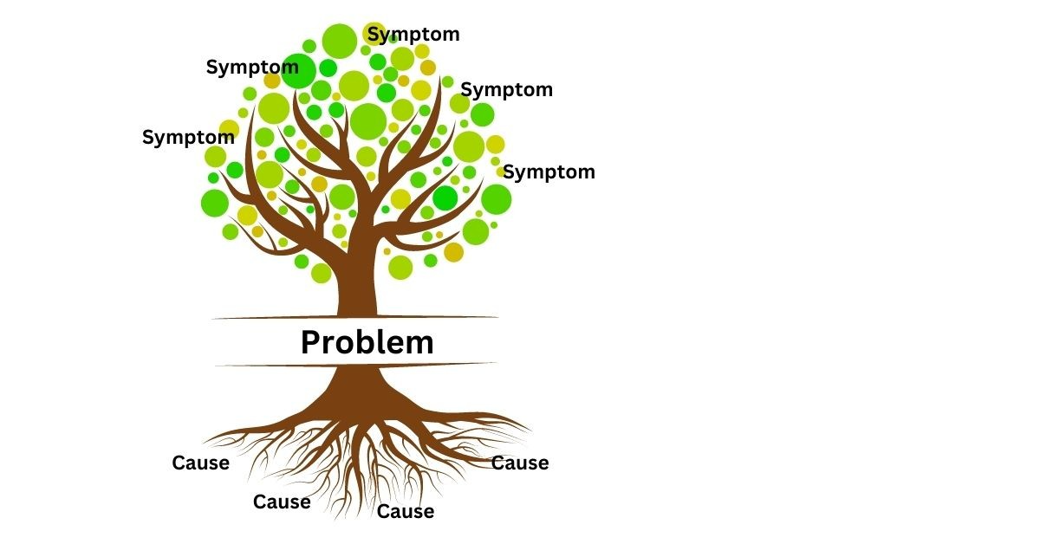
Root Cause Analysis
Identifies causes associated with a problem of interest – Treats causes and not symptoms​
Detects why issue is present
Notes:
To really kick off the PDSA cycle and begin the Plan phase we need to conduct a root cause analysis of the topic you have selected for your CQI project. ​
​
​
A root cause is working to understand an initial cause in a causal chain leading to an outcome in this case an issue that you would like to improve for your program. ​In other words, it is working to identify all the underlying issues that might be causes the problemed area, and the pathway that is leads to the problem area. When CQI teams understand what exactly is causing an issue they are more likely to develop a change strategy that will be successful in alleviating that issue. Meaning that we are treating the disease and not the symptom here because if you don’t identify the root cause of the issue then what will happen is that CQI teams might then temporarily alleviate the issue but it will come back because the key thing that is causing something to happen hasn’t ben addressed.​
​
There are some key things for CQI teams to keep in mind as they are beginning to work on this process. ​
​
All team members have the same goals - this is key here as you worked together through what is your AIM statement keep that in mind when you are working on the root cause. What is your ultimate goal and how can identifying that issue lead to this. ​
​
Focus on processes not individuals - this is to help the team keep in mind that the issue is persistent in the system and not to blame others for the issue that has been identified. For example, if the service plan is not being entered because it might be the oversight of someone in the program, the team should ask themselves was this apart of their onboarding training, is there a system that can be developed from this project that could remind this individual to enter the information? Pointing fingers will not address the issue since it might persist even after that individual has left the program. ​
​
Use open and honest communication and learn from experiences - this goes in line with creating safety within the team/ Everyone should feel comfortable with sharing their perspectives on the topis as it might be the reason you are able to identify the root cause.

Slide 15
Core Principles of Root Cause Analysis
Systems thinking
All team members have the same goals
Focus on processes not individuals
Use open and honest communication and learn from experiences
Decisions based on data and facts
Family focus
Notes:
All team members have the same goals:
Work together through your AIM statement
Focus on processes not individuals:
Helps the team keep in mind that the issue is persistent in the system and not blame others
Use open and honest communication and learn from experiences:
Everyone on the team should feel comfortable sharing their perspectives on a topic as it may lead to an identifying root cause
Decisions based data and facts:
Keep your team on track
Keep from biasing the ideas that are going to be put forward
Family focus:
Keep the focus on how your change idea will improve services delivery to families
Systems thinking:
Think about how the change to the systems will make the program work more efficiently

Slide 16
Steps to Conduct a Root Cause Analysis
Reiterate your topic
(Re)gather data
Identify causal factors
Determine the root cause(s)
Develop a change strategy
Notes:
Reiterate your topic:
What is happening
Identify specific “symptoms” your team sees
State or restate your AIM statement
(Re)gather data:
Look for evidence that the issue is present
How long has the issue occurred for
Identify causal factors:
Think of each step in the process that you are working to improve so that your team can pinpoint where things are not efficient
Identify as many causal factors as possible
Determine your root causes:
Use your root cause analysis tools
Develop a change strategy:
Develop a change strategy to ensure that the problem never happens again

Slide 17
Root Cause Analysis Tools
5 Whys
Questions as to why something is happening
Fishbone diagram
Visual representation of the possible root causes
Brainstorming
Generate thoughts about what might be the root cause of an issue and strategies of how to overcome it
Notes:
Brainstorming:
A group approach that is used to generate thoughts about what might be the root cause of an issue and strategies of how to overcome it
Rules include not judging others’ ideas, encouraging out of the box issues, building upon ideas, generating as many ideas as possible, and recording all of the ideas
5 Whys:
The team asks the first why question (such as “why is this happening”)
The questions become more and more detailed until the last response represents the root cause
There can be more or less than 5 questions
Fishbone Diagram:
Provides a visual representation of the possible root causes
Includes the head (primary issue), spine (connects the ribs), rives (major categories where root causes of the issues are organized), and lines (connect to the ribs that are root causes associated with the ribs categories)

Slide 18

Brainstorming
Brainstorming
A group approach that is used to generate thoughts about what might be the root cause of an issue and strategies of how to overcome it
Rules include not judging others' ideas, encouraging out of the box issues, building upon ideas, generating as many ideas as possible, and recording all of the ideas

Slide 19

5 Whys
5 Whys
The team asks the first why question (such as "why is this happening?")
The questions (can be more or less than 5) become more and more detailed until the last response represents the root cause
Notes:
5 Whys:
The team asks the first why question (such as “why is this happening”)
The questions become more and more detailed until the last response represents the root cause
There can be more or less than 5 questions

Slide 20
Problem: Mothers are not screened for intimate partner violence (IPV)
Why
Staff are hesitant to ask about sensitive topics
Why
Why
Why
Why
There is no formal screening procedure
If we stopped here, change ideas might be limited to creating a formal protocol for screening mothers
Source: HHS

Slide 21
Problem: Mothers are not screened for intimate partner violence (IPV)
Why
Staff are hesitant to ask about sensitive topics
Why
There is no formal screening procedure
Why
Why
Why
The screening tool is not valid
The data system's auto scoring function does not work
Now change ideas move from just implementing a formal screening protocol to considering the validity of the screening tool and data system the results are entered into
Source: HHS

Slide 22
5 Whys
5 Whys
The team asks the first why question (such as "why is this happening?")
The questions (can be more or less than 5) become more and more detailed until the last response represents the root cause
IMPORTANT!
You are not listing 5 reasons why something happens; you are listing 1 reason that you have gone in depth on!
Notes:
Brainstorming:
A group approach that is used to generate thoughts about what might be the root cause of an issue and strategies of how to overcome it
Rules include not judging others’ ideas, encouraging out of the box issues, building upon ideas, generating as many ideas as possible, and recording all of the ideas
5 Whys:
The team asks the first why question (such as “why is this happening”)
The questions become more and more detailed until the last response represents the root cause
There can be more or less than 5 questions
Fishbone Diagram:
Provides a visual representation of the possible root causes
Includes the head (primary issue), spine (connects the ribs), rives (major categories where root causes of the issues are organized), and lines (connect to the ribs that are root causes associated with the ribs categories)

Slide 23
Fishbone Diagram
Fishbone diagram
Provides a visual representation of the possible root causes
Includes the head (primary issue), spine (connects the ribs), ribs (major categories where root causes of the issue are organized), and lines (connect to the ribs that are root causes associated with the ribs categories)
Ribs (major categories)
Head (primary issue)
Spine (connects ribs)
Lines (root causes associated with rib category)
Notes:
Fishbone Diagram:
Provides a visual representation of the possible root causes
Includes the head (primary issue), spine (connects the ribs), ribs (major categories where root causes of the issues are organized), and lines (connect to the ribs that are root causes associated with the ribs categories)

Slide 24
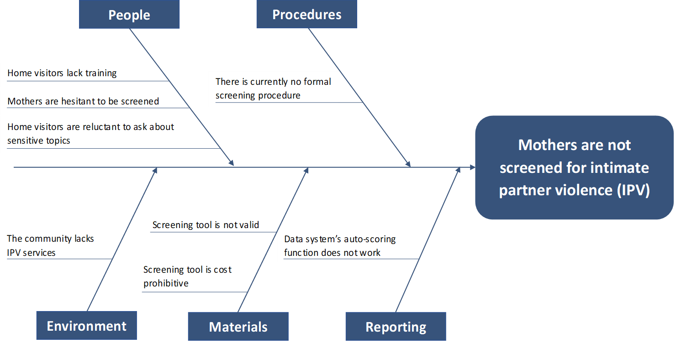
Fishbone Diagram Example
Source: HHS

Slide 25
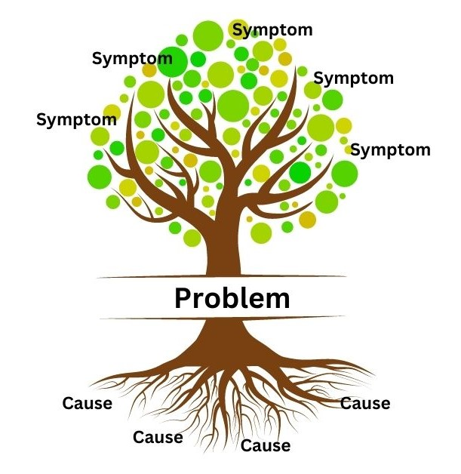
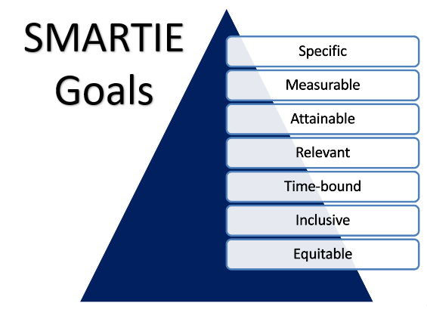
Bringing it Together
Notes:
Once you’ve done all that ground work and you feel that your team has identified the root cause of the issue this is one of those step back before going forward moments causer the team does need to revisit the SMARTIE goals making sure that the root cause of the issue still aligns with each component of the SMARTIE goal and the AIM statement. If all the SMARTIE criteria are still being meet then the CQI team gets to move onto the next portion of the Plan stage in the PDSA cycle.

Slide 26

You're on Your Way!
Notes:
You’re halfway through learning about the CQI process! The next prerecorded workshop will cover the Plan Do Study Act cycle!

